Slide 1
Waste Classification for Recycling Using CNN and Transfer Learning
Guide:
Dr. Y. Lakshmi Prasanna
Assistant Professor, CS-IT
Department:
Department of CS-IT & AI-DS
Academic Year: 2026–27
Presented by:
Keerthana G — 2520090132
Sutte Alekhya — 2520090126

Slide 2
Abstract :
The increasing amount of municipal solid waste has made waste segregation an important challenge. Manual waste segregation is time-consuming, costly, and prone to errors, which can reduce recycling efficiency. To address this problem, our project proposes an AI-based waste classification system using Convolutional Neural Networks (CNN) and Transfer Learning to automatically classify waste images. The system identifies seven categories of waste: Plastic, Paper, Cardboard, Glass, Metal, Organic, and Trash. By automating the classification process, the proposed system can improve recycling efficiency, reduce human effort, and help minimize environmental pollution.

Slide 3
Problem Statement :
The rapid growth of municipal solid waste has become a significant challenge for efficient waste management and recycling. Manual waste segregation is labour-intensive, time-consuming, costly, and highly dependent on human judgment, which can lead to incorrect classification of waste materials. When recyclable materials such as plastic, paper, cardboard, glass, and metal are mixed with organic waste and other trash, their recovery and recycling become less efficient. This creates a need for an intelligent and automated waste classification system that can accurately identify different types of waste from images. Therefore, this project proposes a CNN-based waste classification system with Transfer Learning to automate waste identification, reduce manual effort, improve sorting efficiency, and support more effective recycling and environmentally responsible waste management.

Slide 4
Algorithm :
Convolutional Neural Network (CNN) :
Used for image classification
Automatically extracts image features
Identifies patterns, shapes and textures
Transfer Learning :
Uses a pre-trained deep learning model
Reuses learned image features
Fine-tunes the model for waste classification
Reduces training time

Slide 5
Dataset Identification :
Garbage Classification Dataset / Trash Net Dataset
Waste Categories:
Plastic
Paper
Cardboard
Glass
Metal
Organic Waste
Trash
Dataset structure
├── Plastic
├── Paper
├── Cardboard
├── Glass
├── Metal
├── Organic
└── Trash

Slide 6
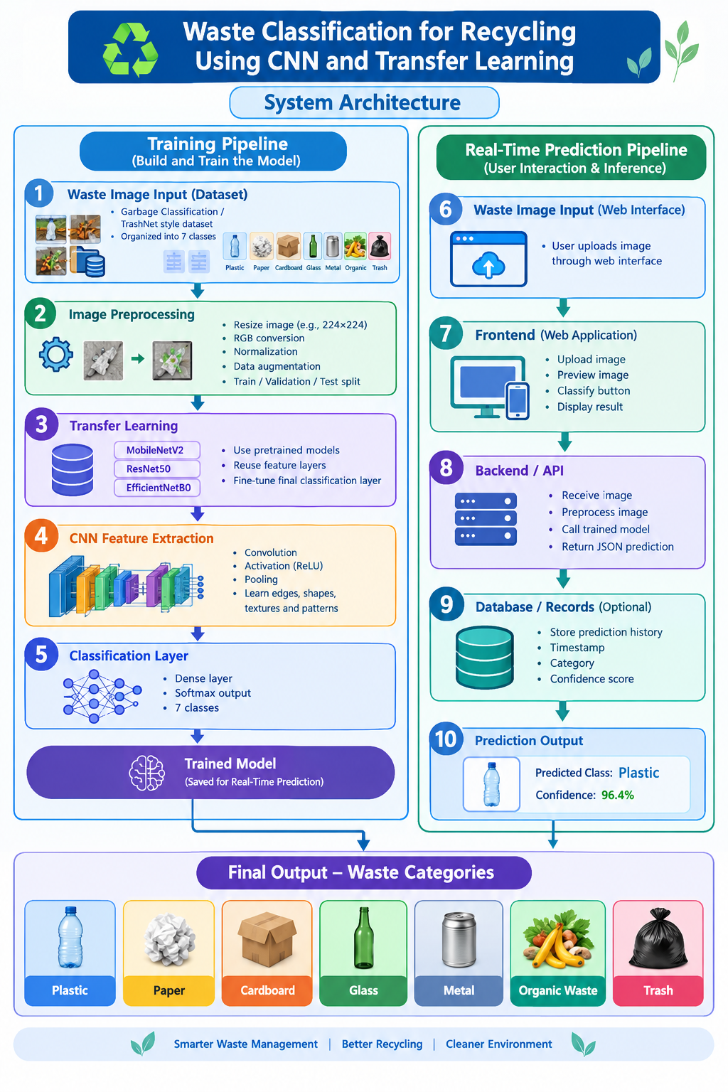
System Architecture :

Slide 7
Conclusion :
The Waste Classification for Recycling Using CNN and Transfer Learning project provides an AI-based approach to automate the identification and classification of different types of waste. By using CNN techniques and pre-trained models such as MobileNetV2, ResNet50, and EfficientNetB0, the system can learn important visual features such as shapes, textures, and patterns from waste images. The system classifies waste into Plastic, Paper, Cardboard, Glass, Metal, Organic Waste, and Trash. Overall, the proposed approach can reduce dependence on manual segregation, save human effort, support efficient waste sorting, and contribute to improved recycling and better environmental management.

Slide 8
Thank you

